Slide 1
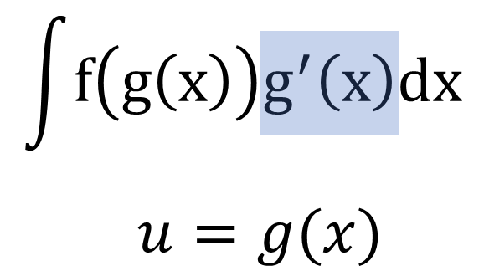
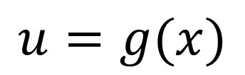

$$\int{f\left(g\left(x\right)\right)g^{′}\left(x\right)dx}$$
$$u=g(x)$$

Slide 2
$$\int{f\left(g\left(x\right)\right)g^{′}\left(x\right)dx}$$
$$u=g(x)$$

